Slide 1
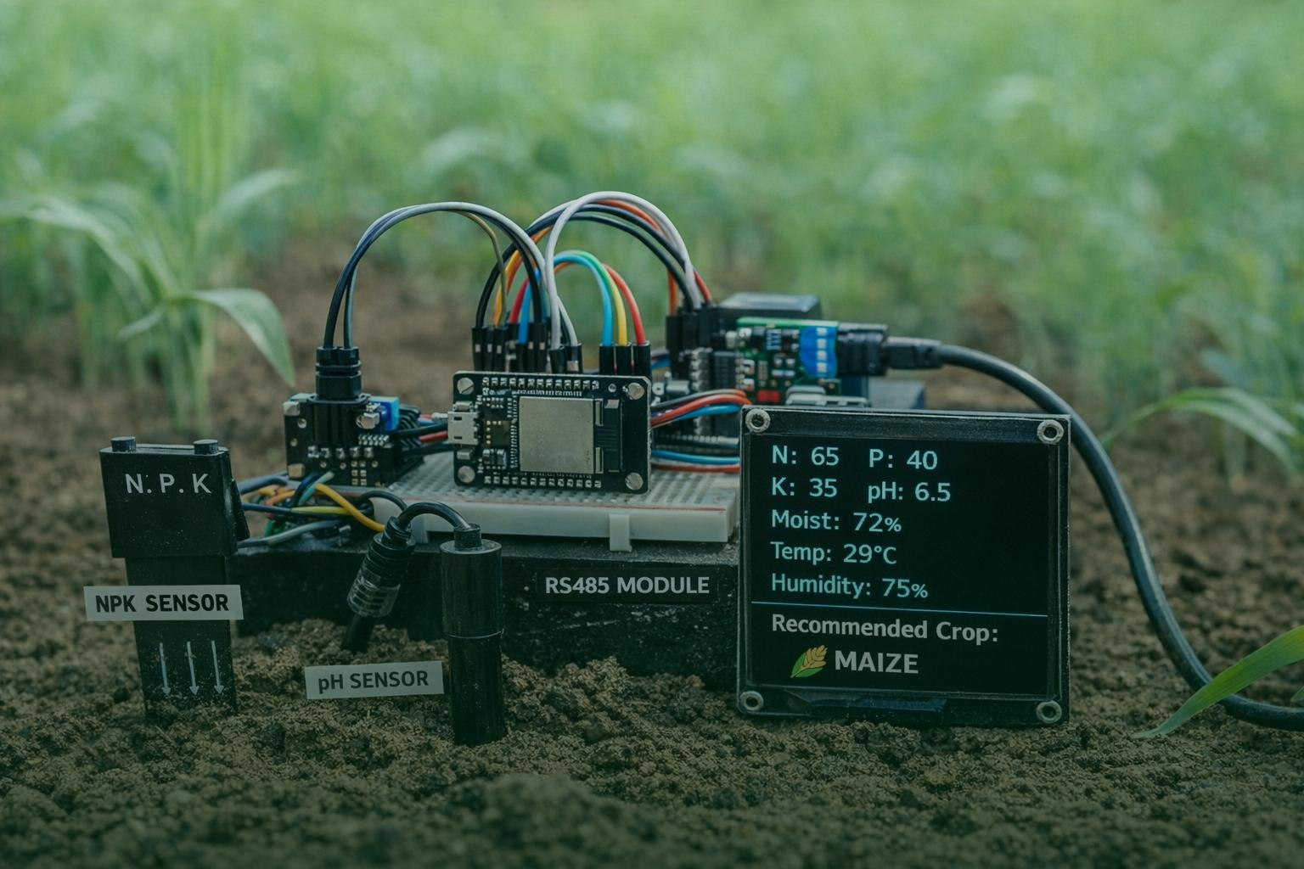
Smart Soil Monitoring
and Crop
Recommendation Device
(IoT + Machine Learning based Smart Agriculture)

Slide 2
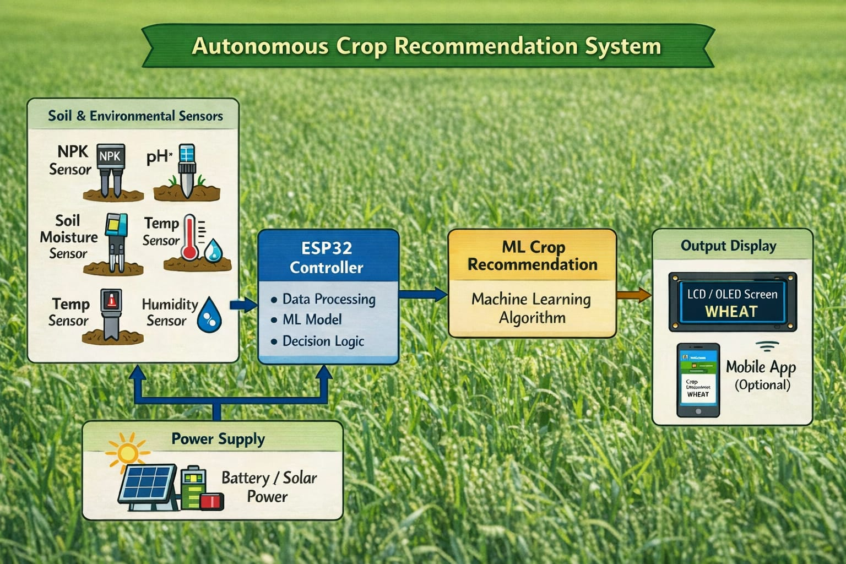
Conclusions
↓

Slide 3
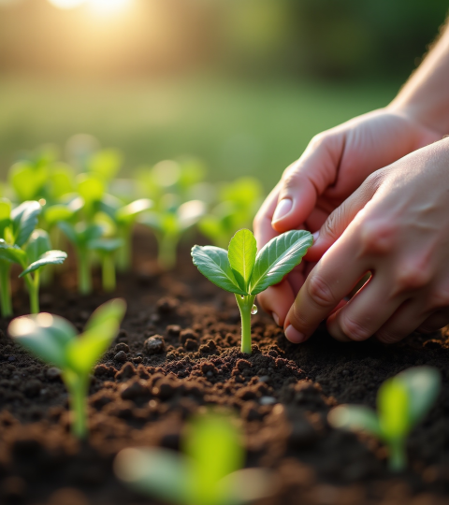
Functionality :
Measure soil parameters: N, P, K, pH, moisture, temperature, humidity
Recommends best suitable crop
Displays results on LCD/OLED screen
Works as a standalone device (no internet required

Slide 4

Software:
)
Hardware:
ESP32 Microcontroller
NPK Soil Sensor
Soil pH Sensor
Capacitive Soil Moisture Sensor
DHT11 / DHT22 (Temperature
& Humidity)
MAX485 RS485 Converter
OLED / 16×2 LCD Display
Power Supply / Battery
Components:
Arduino IDE
(ESP32 programming)
Embedded C / C++
Serial communication (RS485)
Sensor data acquisition
& calibration
Display interface (I2C)
Rule-based decision logic

Slide 5
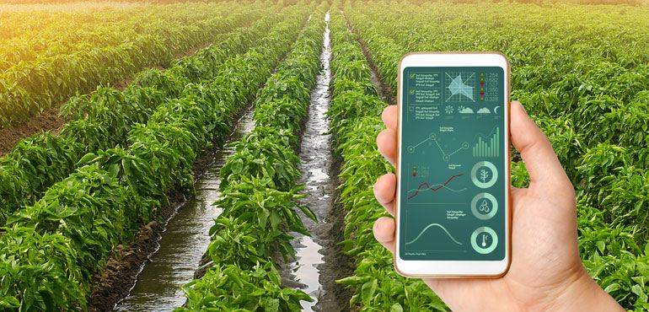
Conclusion:
Developed a low-cost smart soil analysis system
Provides accurate crop recommendation
Portable, fast, and easy to use
Suitable for real-time agricultural applications

Slide 6
Thank
You!

